Slide 1

Tutorial 7

Slide 2
Topic 1
What are the differences between structured and semistructured data?

Slide 3
Aspect | Structured Data | Semistructured Data
Definition
Storage
Schema
Examples
Search and Query
Data Integrity
Flexibility
Query Complexity
Use Cases

Slide 4
Aspect | Structured Data | Semistructured Data
Definition | Highly organized, follows a strict schema. | Organized but flexible, follows a loose schema.
Storage | Relational databases (RDBMS). | NoSQL databases, XML, JSON files.
Schema | Rigid, predefined before data storage. | Flexible, can be defined with the data.
Examples | SQL databases, Excel spreadsheets, CSV files. | XML files, JSON files, NoSQL databases.
Search and Query | SQL queries, straightforward due to fixed schema. | Requires specialized query languages like XPath or JSON query.
Data Integrity | High, with strict constraints (primary/foreign keys). | Less strict, more flexible integrity rules.
Flexibility | Low, difficult to adapt to changes. | High, easily adapts to new fields/data types.
Query Complexity | Often simpler due to uniform structure. | Can be complex due to varied structures.
Use Cases | Banking systems, inventory management, ERP systems. | Web data, configuration files, data interchange.

Slide 5
Topic 1
What are the differences between structured and semistructured data?
Schema: Structured data has a fixed schema, whereas the schema for semi-structured data is more flexible and can vary within the same dataset.
Storage: Structured data is commonly stored in relational databases (e.g., MySQL, PostgreSQL), while semi-structured data is often stored in non-relational databases (e.g., MongoDB, Couchbase) or as flat files (e.g., JSON, XML files).

Slide 6
Topic 1
What are the differences between structured and semistructured data?
Querying: Structured data can be easily queried with SQL, whereas semi-structured data usually requires specialized querying mechanisms (e.g., XPath for XML, query methods for NoSQL databases).
Complexity: Semi-structured data can represent more complex relationships, including hierarchical or nested data, which would be more difficult to represent in a strictly tabular format.
Flexibility: Semi-structured data formats are often better suited for agile development processes where data schemas need to evolve over time.
Type of Data: Structured data is often numeric or categorical data that fits neatly into tables. Semi-structured data can include this kind of data but also can include things like arrays or objects that encapsulate more complex relationships.

Slide 7
Topic 2
What are the features of XML? What are the differences between XML and HTML? What are the differences between the uses of tags in XML versus HTML?

Slide 8
What are the features of XML?
Feature | Description
Self-descriptive
Customizable Tags
Data Separation
Hierarchical Structure
Wide Compatibility
Human and Machine Readable
Extensible
Unicode Support
Validation

Slide 9
What are the features of XML?
Feature | Description
Self-descriptive | XML tags are user-defined to describe the data.
Customizable Tags | Users can create their own custom tags.
Data Separation | Focuses on the data itself, not how it looks.
Hierarchical Structure | Organizes data with parent-child relationships.
Wide Compatibility | Can be used across different systems and platforms.
Human and Machine Readable | The format is accessible to both humans and computers.
Extensible | Allows for the structure to be expanded without affecting existing data.
Unicode Support | Can represent a vast range of characters from various languages.
Validation | Can be validated against a schema for structural integrity.

Slide 10
Differences between XML and HTML:
Aspect | XML | HTML
Purpose
Tags
Structure
Validation
Strictness

Slide 11
Differences between XML and HTML:
Aspect | XML | HTML
Purpose | Designed to store and transport data. | Designed to display data.
Tags | Custom tags created by the author. | Predefined tags understood by browsers.
Structure | Flexible, user-defined document structure. | Specific structure to follow.
Validation | Documents can be validated against a schema or DTD. | Standards like HTML5 are used for validation.
Strictness | Strict in tag closure and nesting. | More lenient with tag closure and nesting.

Slide 12
Tag Usage in XML vs. HTML:
Aspect | XML | HTML
Tags
Semantics
Extensibility
Nesting

Slide 13
Tag Usage in XML vs. HTML:
Aspect | XML | HTML
Tags | Case-sensitive, must be closed. | Case-insensitive, more flexible in closing.
Semantics | Tags are intended to convey meaning of data. | Tags are intended to convey data presentation.
Extensibility | Can define new tags as needed. | Must use existing predefined tags.
Nesting | Must be properly nested. | Nesting can be improper in older HTML versions.

Slide 14
Differences in Tag Usage in XML vs. HTML
Case Sensitivity:
XML: Tags are case-sensitive. <Name> and <name> would be considered different elements.
HTML: Tags are not case-sensitive.
Closing Tags:
XML: All elements must be closed, either with a closing tag (<name></name>) or as a self-closing tag (<name/>).
HTML: Some elements don't require closing tags (e.g., <img>, <input>).
Attribute Quotes:
XML: Attribute values must always be enclosed in quotes.
HTML: While it's best practice to use quotes, they are often optional.
User-Defined Tags:
XML: Allows for user-defined tags.
HTML: Does not allow user-defined tags but does allow custom "data-" attributes.
Semantic Meaning:
XML: Tags have no predefined semantic meaning.
HTML: Tags like <table>, <header>, <nav> have specific semantic meaning.

Slide 15
Common use cases
Configuration Files
Example: Software and applications often use XML files for storing configuration settings that can easily be read and updated programmatically.
<config>
<server>localhost</server>
<port>8080</port>
<database>myDatabase</database>
</config>

Slide 16
Common use cases
Data Interchange
Example: XML is used as a data format for exchanging information between different systems, especially in web services like SOAP.
<PersonInfo>
<FirstName>John</FirstName>
<LastName>Doe</LastName>
<Email>john.doe@example.com</Email>
</PersonInfo>

Slide 17
Common use cases
Document Storage
Example: Some document databases use XML to store complex, hierarchical data, where the XML tags serve as descriptors for the data they contain.
<Book>
<Title>The Great Gatsby</Title>
<Author>F. Scott Fitzgerald</Author>
<Year>1925</Year>
</Book>

Slide 18
Common use cases
RSS Feeds
Example: RSS (Really Simple Syndication) feeds are often in XML format and provide a way to distribute updates and news content.
<rss version="2.0">
<channel>
<title>My News Feed</title>
<item>
<title>First News</title>
<link>http://example.com/first-news</link>
</item>
</channel>
</rss>

Slide 19
Common use cases
GUI Configuration
Example: Some desktop applications use XML files to define elements of the user interface, such as menu structures and toolbar buttons.
<menu>
<item label="File">
<subitem label="Open" action="openFile"/>
<subitem label="Save" action="saveFile"/>
</item>
</menu>

Slide 20
Common use cases
Messaging Protocols
Example: XMPP (eXtensible Messaging and Presence Protocol) for chat and messaging applications uses XML for structuring its messages.
<message to="user@example.com" from="friend@example.com">
<body>Hello, how are you?</body>
</message>

Slide 21
Common use cases
Scientific, Technical, and Medical Data
Example: XML is often used to structure scientific data, making it easier to share and analyze.
<experiment>
<name>Photosynthesis Rate</name>
<observation>
<lightIntensity>1000</lightIntensity>
<rate>5.5</rate>
</observation>
</experiment>

Slide 22
Common use cases
Invoice and Financial Reports
Example: Invoices and financial data can also be represented in XML to allow for easier data manipulation and readability.
<Invoice>
<Item>
<ProductName>Laptop</ProductName>
<Price>1000</Price>
</Item>
</Invoice>

Slide 23
Topic 3
Review the well-formedness and validity of XML, the rules for well-formedness and the purpose of DTD.

Slide 24
Well-Formedness in XML
1.Element Nesting: Elements must be properly nested within each other. For example, <a><b></b></a> is well-formed, but <a><b></a></b> is not.
2.Case Sensitivity: XML is case-sensitive. For example, <Tag> is not the same as <tag>.
3.Closing Tags: All elements must have a closing tag, or they must be self-closed. For example, <a></a> and <a/> are well-formed, but <a> is not.
4.Root Element: There must be a single root element that contains all other elements.
5.Attribute Quotation: Attribute values must be enclosed in quotes. Both single (' ') and double quotes (" ") are allowed.
6.Well-Formed Declarations: If an XML declaration is included, it must be at the top of the document.
7.Special Characters: Special characters like <, >, &, etc., must be encoded as entities (&lt;, &gt;, &amp;, etc.).
8.Attribute Uniqueness: An element can have multiple attributes, but they must be unique within that element and must be quoted.

Slide 25
Validity in XML
An XML document is considered valid if it is well-formed and also conforms to a Document Type Definition (DTD) or an XML Schema Definition (XSD).

Slide 26
Document Type Definition (DTD)
A DTD specifies the structure of an XML document, defining what elements and attributes are allowed and how they should be organized. Here are some of the purposes of DTD:
Element Declarations: Specifies what elements are allowed in the document.
Attribute Declarations: Specifies what attributes are allowed in each element, along with their types and default values.
Entity Declarations: Defines entities that can be reused in the document.
Notations: Specifies the format of external resources.

Slide 27
<!DOCTYPE book [
<!ELEMENT book (title, author)>
<!ELEMENT title (#PCDATA)>
<!ELEMENT author (#PCDATA)>
]>
<book>
<title>The Great Gatsby</title>
<author>F. Scott Fitzgerald</author>
</book>
In this example, the DTD specifies that a book element must contain one title and one author element, each of which contains parsed character data (#PCDATA).

Slide 28
Topic 4
Check the following statements about XML documents. Which is true? Which not?
1) There exists one and only one element that contains all other elements.
2) An XML document must conform to some DTD.
3) Elements are allowed to overlap.
4) The value of an attribute of any element must be enclosed in double quotes or single quotes.
5) Elements with the same tag must have identical structure.
6) You can use the same name for two or more attributes of the same element.

Slide 29
There exists one and only one element that contains all other elements.
True: An XML document must have a single root element that contains all other elements.
An XML document must conform to some DTD.
False: While an XML document can conform to a DTD (or an XML Schema), it is not a requirement for the document to be considered well-formed. Validity (conformance to DTD or XML Schema) is separate from well-formedness.
Elements are allowed to overlap.
False: Elements must be properly nested within each other and cannot overlap. For example, <a><b></b></a> is well-formed, but <a><b></a></b> is not

Slide 30
The value of an attribute of any element must be enclosed in double quotes or single quotes.
True: Attribute values in XML must be enclosed in quotes, either single (' ') or double (" ").
Elements with the same tag must have identical structure.
False: Elements with the same tag name do not necessarily need to have identical structure unless it is defined in a DTD or XML Schema. In a well-formed XML document without a DTD or XML Schema, the structure can differ.
You can use the same name for two or more attributes of the same element.
False: Within the same element, each attribute must have a unique name.

Slide 31
Check the following statements about XML documents. Which is true? Which not?
1) There exists one and only one element that contains all other elements. (Y)
2) An XML document must conform to some DTD. (N)
3) Elements are allowed to overlap. (N)
4) The value of an attribute of any element must be enclosed in double quotes or single quotes. (Y)
5) Elements with the same tag must have identical structure. (N)
6) You can use the same name for two or more attributes of the same element. (N)

Slide 32
Topic 5
Design a DTD for the following XML document. We assume that this XML document is informative. After the DTD is designed, use it to validate the XML document both internally and externally.

Slide 33
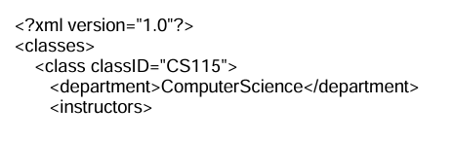
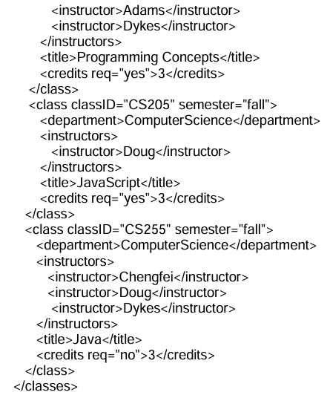
Design a DTD for the following XML document. We assume that this XML document is informative. After the DTD is designed, use it to validate the XML document both internally and externally.

Slide 34
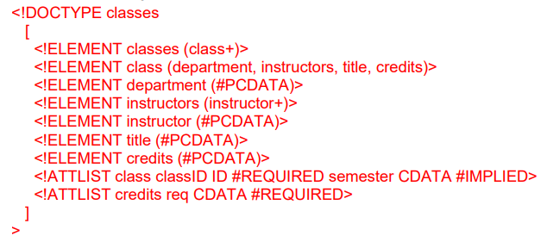

Slide 35
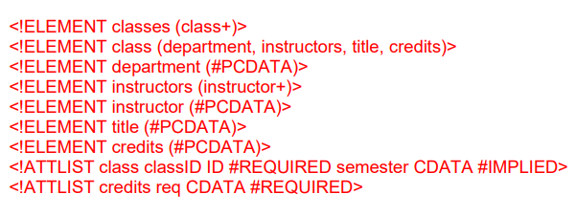
Classes.dtd
<!DOCTYPE classes SYSTEM "classes.dtd">

